Slide 1


Lists, tuples, and
dictionaries
(data structures)

Slide 2
Recap!
We should know how to…
Create for loops
Create functions
Know the difference between print and return
Defining local and global variables
Using string functions
Understand immutability

Slide 3
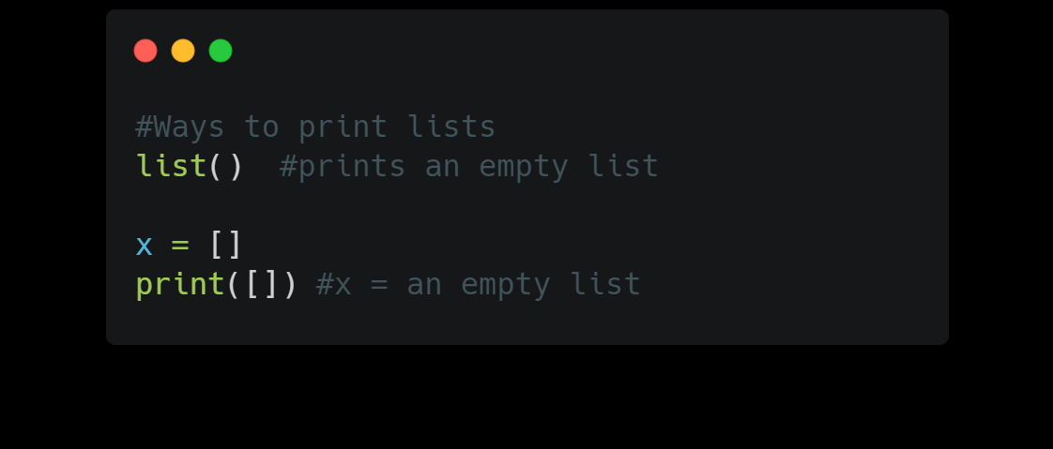
lists
Used to store a collection of data
Should have square brackets []
Items are split using commas ,
Unlike strings, lists are mutable
Can mix element types
Python doesn’t natively support arrays like in other languages like Java (use numpy for ndarray)

Slide 4
List methods
append() adds an element at the end
clear() removes all elements
copy() copies the list
len() returns the number of elements in list
extend() add another list to a current list
index() returns the index value specified
insert() adds an element in a specific position
pop() removes an element in a specific position
remove() removes an item with specified value
reverse() reverse the order of the list
sort() sorts the lists

Slide 5
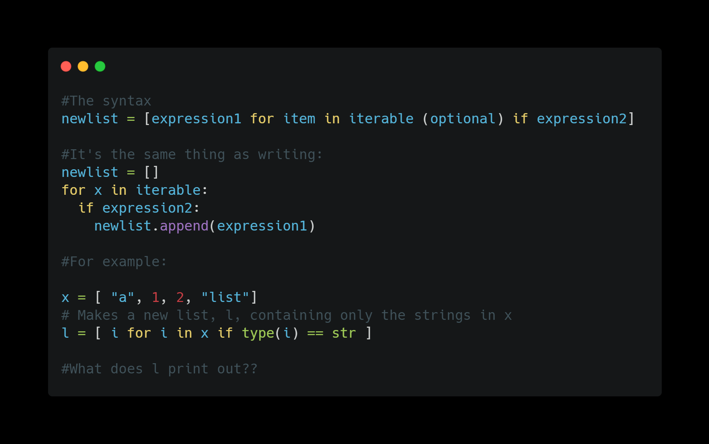
List comprehension
Creating a list with conditionals in one line

Slide 6
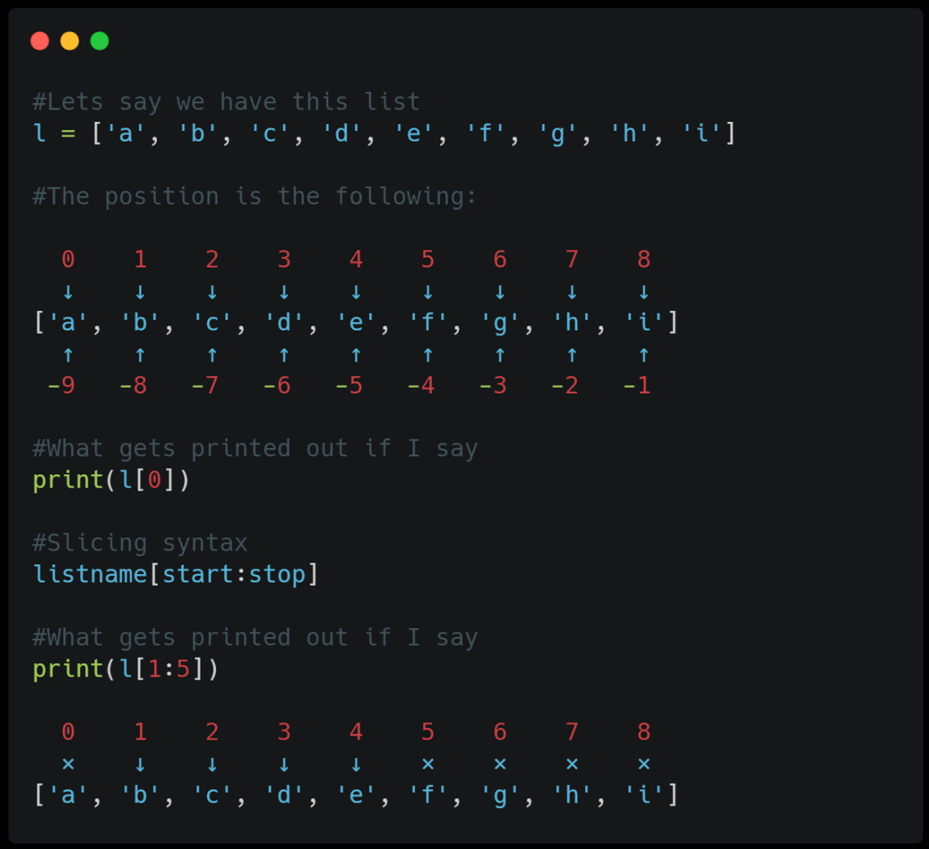
indexing
The position of an element when iterating
Use the index operator []
First position starts as 0

Slide 7
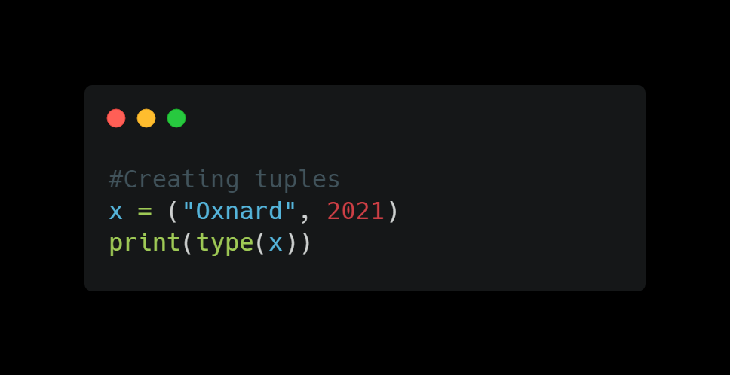
tuples
Used to store a set collection of unchanged data
Unlike lists, tuples are immutable
Allow duplicates
Should have () parenthesis
Shares most methods with lists

Slide 8
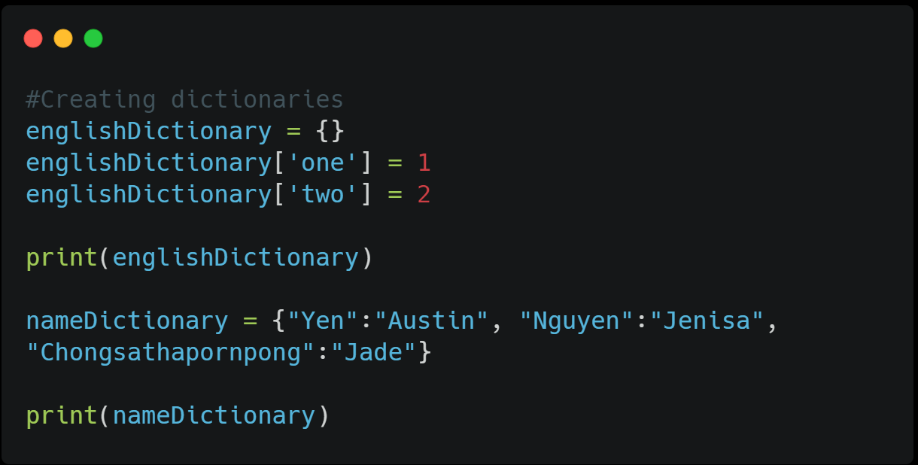
dictionaries
Used to store data in the form of keys and values
Mutable
Should be denoted in {}
Uses methods shown before
keys() returns a list with the dictionary’s keys
values() returns a list with the dictionary’s values
get() returns the value of a specified key
Aka a hash map or hash table
Faster than searching through a list

Slide 9
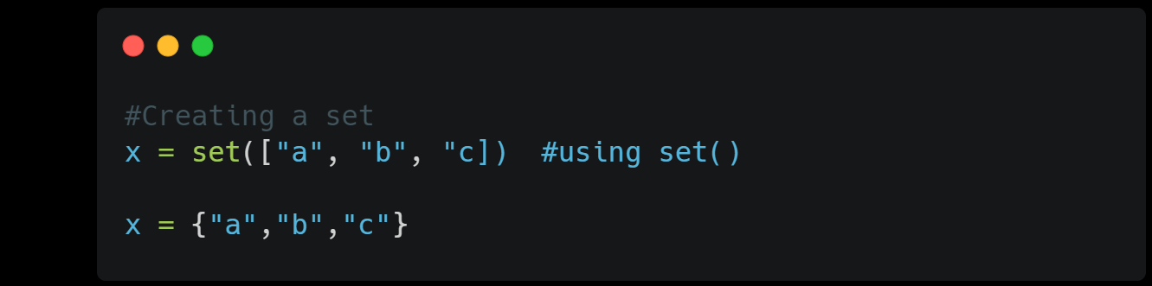
sets
Used to store unique objects
Not ordered and not mutable
Written in curly brackets {}
Shares some of the same methods as other structures
You will use sets in discrete math
difference() returns the differences of 2 or more sets
intersection() returns a set containing the intersection
issubset() returns whether a set is in another set
isdisjoint() returns if theres an intersection or not
union() return the union of 2 or more sets

Slide 10
In short…
List: Ordered and changeable, allows duplicates
Tuple: Ordered and unchangeable, allows duplicates
Set: Unordered and not indexed, no duplicates
Dictionary: Unordered and changeable, no duplicates

Slide 11
When do I use these?
List: A simple, iterable collection that will be modified frequently
Tuple: Unchanged, fixed data
Set: Finding uniqueness in the data, discrete math
Dictionary: When you need a logical association with keys and values. Fast lookup and needs modification

Slide 12
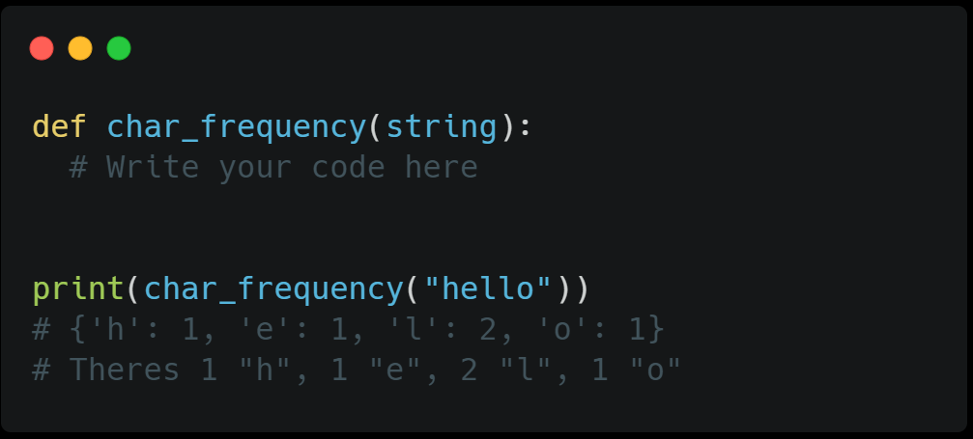
Challenge!!
Write a function to count the number of characters in a string and stores in a dictionary.
Hint:
Create a dictionary
Iterate through all the elements in the given array (passed through from string)
Set it as the keys in the dictionary (refer how to set keys in notebook)
Check if the element is in the keys, +1 if there are multiple occurances, or else make it = 1 if it occurs once
return / print the function

Slide 13
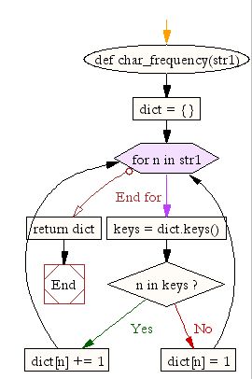
Still stuck?

Slide 14
Thanks!!
Email: ayyen@ucsc.edu

